Slide 1
Research Experience 2
With Zhen Lu and Yue Yang

Slide 2
Part 1(2024.1-2024.4) Computational Fluid Dynamics and Artificial Intelligence
Overview: The emergence of ChatGPT has made people realize the power of AI. For engineers, AI is also a powerful tool for assisting in programming and numerical computations. This research project utilizes ChatGPT and the open-source AI program CHATGLM developed by Tsinghua University, China, to explore the impact of different prompts on AI programming for numerical fluid mechanics calculations. Additionally, it attempts to use multimodal models to solve computational fluid dynamics problems. For example, it investigates how to structure prompts so that AI can better understand boundary and initial conditions and provide appropriate computational formats. Furthermore, it explores the possibility of converting boundary shapes into images for input into multimodal models.

Slide 3
Research Summary and Findings
Due to the overlap of this research with the Computational Fluid Dynamics (CFD) course during the same semester, only a few simple CFD models were studied. Although no significant conclusive results were achieved, this research experience allowed me to learn how to use common CFD methods with Python and MATLAB to solve problems. Additionally, I became more proficient in using ChatGPT, and learning about open-source models helped me acquire the skills to download and deploy them. These experiences have been highly beneficial for me.

Slide 4
Some empirical conclusions:
Provide numerical formats and handling methods for the computational domain and various types of boundaries separately, avoiding singularities at corner points.
Avoid ambiguity when describing boundary shapes to ensure uniqueness (when converting to images for processing by multimodal models, use common symbols and annotation methods to mark information as comprehensively as possible).
When solving more complex problems, break the problem down into steps, ensuring that each step is not too lengthy.
The ability to understand certain formats (e.g., special shock-capturing formats) is relatively weak, so it is necessary to input the relevant format information before running.
Overall, AI can handle problems with simple boundary conditions and fewer computational steps quite well. When dealing with more complex problems, if the boundary conditions and computational formats are relatively simple, it is also possible to avoid the AI from stopping calculations or making errors by breaking the problem down into smaller tasks, provided that the AI fully understands the boundary conditions and computational formats.

Slide 5
Part 2(2024.4-present) Quantum computing of fluid dynamics
Overview: Quantum computing has emerged to be the next disruptive technology since Feynman pointed out the enormous potential of quantum simulation. Compared to conventional digital computing, quantum computing can dramatically reduce the execution time, memory usage, and energy consumption. We attempt to use quantum computing to solve fluid mechanics problems. But simulating fluid dynamics on a quantum computer is intrinsically difficult due to the nonlinear and non-Hamiltonian nature of the Navier-Stokes equation. We attempt to solve some of these problems.

Slide 6
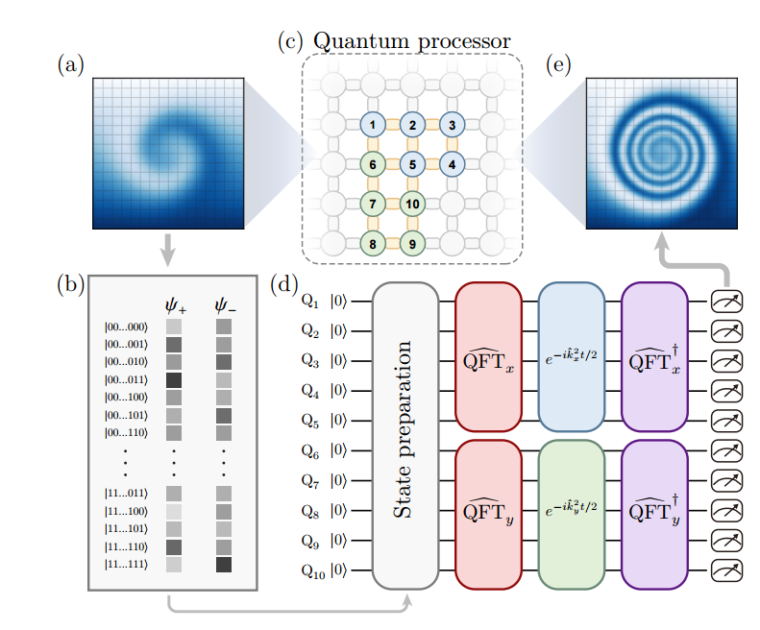
How to proceed ?
(1) Encoding the physical information of fluid into quantum state information. [(a),(b)]
(2) Linearizing the Navier-Stokes equations or transport equations, or transforming them into the Schrödinger form, and then constructing quantum circuits for computation based on the specific forms (sometimes requiring a Fourier transform of the quantum states). [(c),(d)]
(3) Extracting the physical information of the fluid from the resulting quantum states. [(e)]

Slide 7
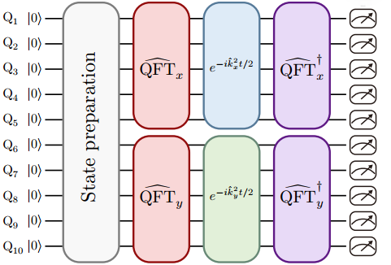
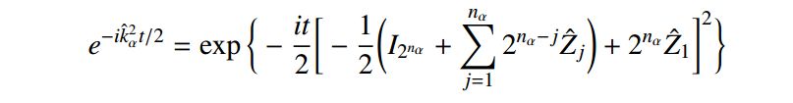
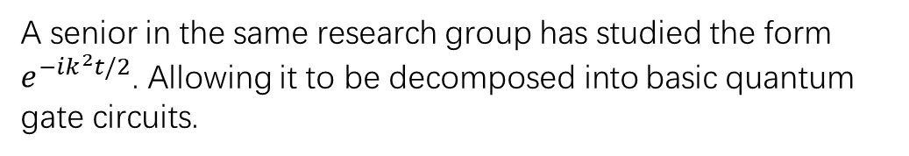
Some of my research
Finding a universal form of quantum circuits that can compute a wider variety of equations.
A senior in the same research group has studied the form $e^{−ik^{2}t/2}$. Allowing it to be decomposed into basic quantum gate circuits.

Slide 8
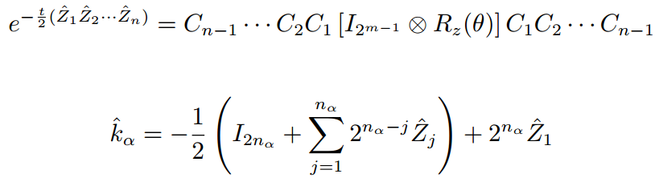
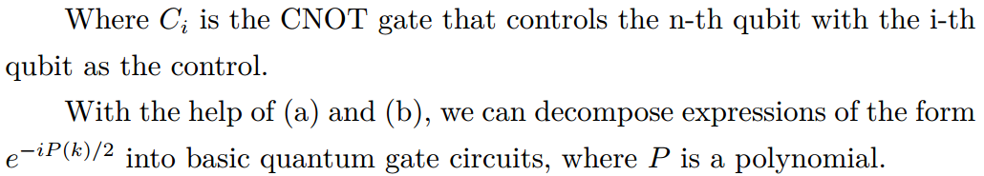
Building on my senior's research, I discovered that the square of 𝑘 can be replaced with a polynomial form of 𝑘, which can further be approximated through a Taylor expansion for a general form.
(a)
(b)

Slide 9
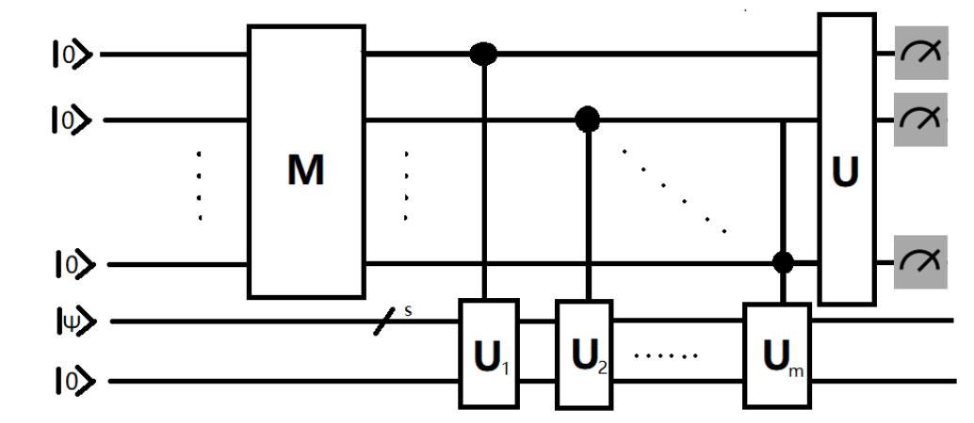
Another discovery: a method was found to extract physical information from multiple quantum states simultaneously.
The original measurement method required constructing multiple quantum circuits for measurement. However, the newly discovered method allows obtaining results through multiple measurements using a single quantum circuit. For detailed information, please refer to [Quantum Measurement.pdf] on my personal website.

Slide 10



Failed attempt: transforming nonlinear equations into Schrödinger-like form.
In the research group, a Schrödinger-like transformation was successfully applied to a simple diffusion equation. However, after replacing the linear source term with a nonlinear source term, no effective method for the Schrödinger-like transformation was found.
?
?

Slide 11
Reference
[1] Zhengyuan Yang, Linjie Li, Kevin Lin, Jianfeng Wang, Chung-Ching Lin,Zicheng Liu, Lijuan Wang, The Dawn of LMMs:Preliminary Explorations with GPT-4V(ision).
[2] Ali Kashefi, Tapan Mukerji, ChatGPT for Programming Numerical Methods.
[3] Zhaoyuan Meng and Yue Yang, Quantum computing of fluid dynamics using the hydrodynamic Schrödinger equation, PHYSICAL REVIEW RESEARCH 5, 033182 (2023).
[4] Zhaoyuan Meng and Yue Yang, Quantum spin representation for the Navier-Stokes equation.
[5] Zhen Lu, Yue Yang, Quantum computing of reacting flows via Hamiltonian simulation.

Slide 12
Reference
[6] Zhaoyuan Meng,Jiarun Zhong, Shibo Xu, Ke Wang,Jiachen Chen, Feitong Jin, Xuhao Zhu, Yu Gao, Yaozu Wu, Chuanyu Zhang, Ning Wang, Yiren Zou, Aosai Zhang, Zhengyi Cui, Fanhao Shen, Zehang Bao, Zitian Zhu, Ziqi Tan, Tingting Li, Pengfei Zhang, Shiying Xiong, Hekang Li, Qiujiang Guo, Zhen Wang, Chao Song, H. Wang, and Yue Yang, Simulating unsteady fluid flows on a superconducting quantum processor.

